Slide 1

Housing Sales Price and Venues Analysis for Liverpool
Sylwia Mierzejowska
Coursera Capstone Project
2020

Slide 2

INTRODUCTION
This project has been created to help people who wants to move to Liverpool or investors who wants to start a new business decide which location will be the optimum to choose based on the analysis of venues of different areas in Liverpool and average housing prices.

Slide 3

Liverpool Overview
Liverpool is a city and metropolitan borough in Merseyside, England. The population in 2019 was approximately 498,042. Liverpool is the ninth-largest English district by population, and the largest in Merseyside and the surrounding region. It lies within the UK's sixth-most populous urban area, and its metropolitan area is the fifth-largest in the UK with a population of 2.24 million. Liverpool is the sixth-most-visited UK city. It is noted for its culture, architecture, and transport links. The city is closely associated with the arts, especially music; the popularity of the Beatles, widely regarded as the most influential music group in history, contributed to the city's status as a tourist destination.

Slide 4
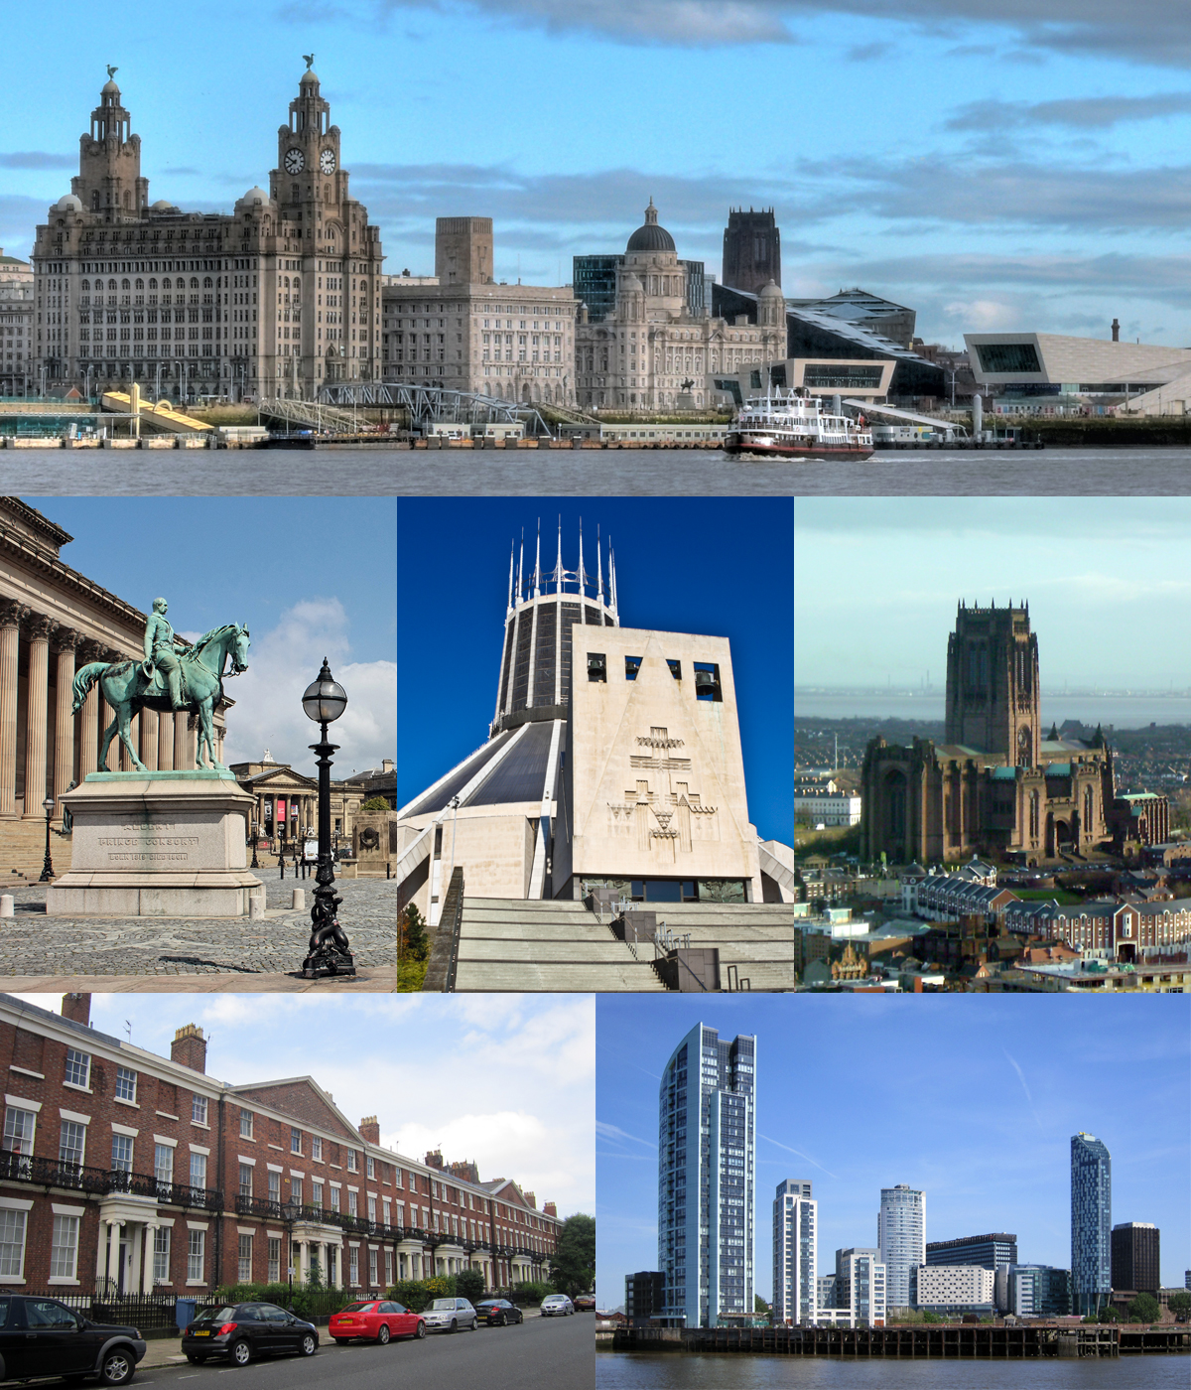
Liverpool Overview
Several areas of the city centre were granted World Heritage Site status by UNESCO in 2004, and its collection of parks and open spaces has been described as the "most important in the country" by the Register of Historic Parks and Gardens of Special Historic Interest. Its status as a port city has attracted a diverse population from a wide range of cultures and religions, primarily Ireland, Norway, and Wales. It is also home to the oldest black community in the UK and the oldest Chinese community in Europe. Natives and long-time residents of Liverpool are formally referred to as "Liverpudlians" but are more often called "Scousers", a reference to the form of stew made popular by sailors in the city and the most common name for the Liverpool accent and dialect. The city celebrated its 800th anniversary in 2007 and was named the 2008 European Capital of Culture, jointly with Stavanger, Norway.

Slide 5
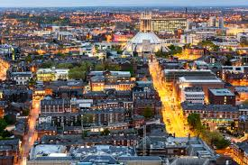
Problem
Liverpool is a city with a high population and population density hence it might be a challenge for investors to find a best place to open their business taking into account a lower real estate costs and depending on the nature of their business also less competitive area. On the other hand residents of the city might be more interested in a lower properties prices but areas that are more attractive due to majority of a social places. Unfortunately this information is not easy to find nowadays that will guide investors which district/areas to choose taking into account these indexes.

Slide 6
DATA
To find a solution of a problem appropriate data had to be collected, cleaned and processed.
Gathering data
Processing Data
Obtained a list of postcodes and areas of City of Liverpool from doogal.co.uk. The csv file consists of many valuable information and coordinates for each postcode areas. File required data cleaning but consist of coordinates of all areas.
Obtained a data of average house prices (collected by postcodes) from website propertydata.co.uk, converted the data into a data frame and cleaned and removed unnecessary data.
Combined two data frame together.
Used Foursquare API to get the most common venues of areas of Liverpool.
Created a graphs, tables and maps to show the results.

Slide 7
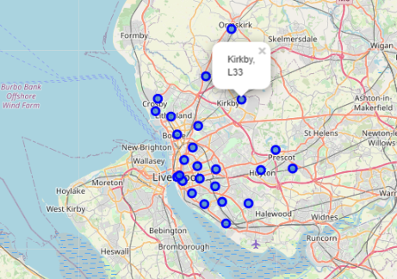
Areas of Liverpool
Folium library has been used to visualize geographic details of Liverpool by postcodes and areas names.

Slide 8
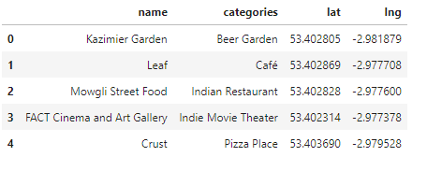
Exploring and segmenting the areas
Foursquare API used to explore and segment the areas of Liverpool. Limit set to 100 venues and radius to 750 m for each area from latitude and longitude information. In total 100 venues and 113 unique categories have been returned from Foursquare. Here is the first 5 elements of the list of venues names, category latitude and longitude information.

Slide 9
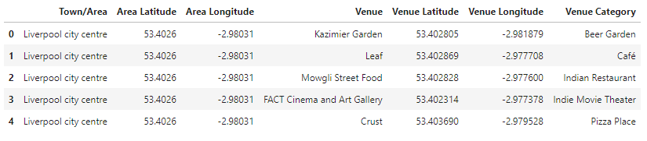
VENUES DATA FRAME
Areas and venues data frame after merging.

Slide 10
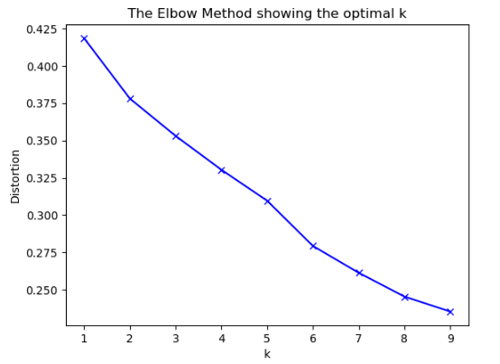
K-Means algorithm
The most common cluster method of unsupervised learning algorithm K-Means has been selected to cluster the areas. The optimum k for K-Means algorithm found using Elbow method and applied Euclidean distance.

Slide 11
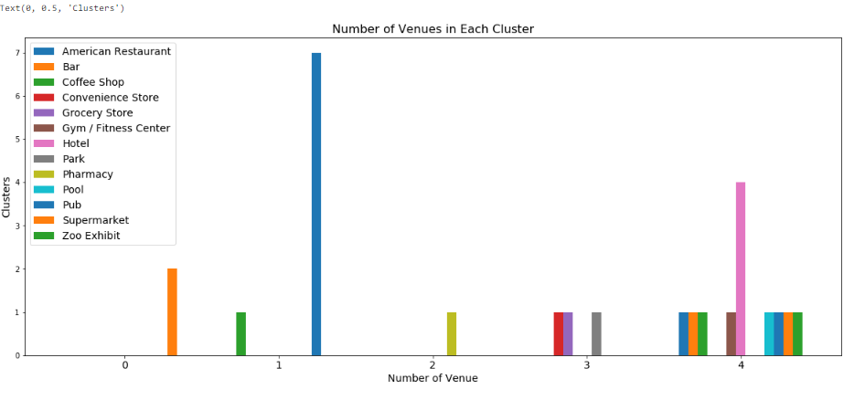
Bar chart
Bar chart has been created to help finding names of clusters as follow:
0 – Bars venues
1 – Pubs and Restaurants
2 – Stores
3 – Pharmacy Venues
4 - Hotels, Gyms and accommodation Venues

Slide 12
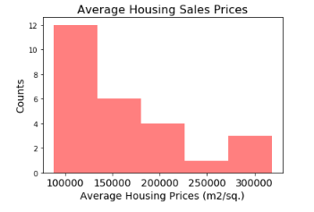
Histogram
New data frame created to enable creation of a histogram to define the ranges of average housing sales prices:
100000 AHP : "Low Level HSP"
100000-150000 AHP : "Mid-1 Level HSP"
150000-200000 AHP : "Mid-2 Level HSP"
200000-250000 AHP : "High-1 Level HSP"
>250000 AHP : "High-2 Level HSP"

Slide 13
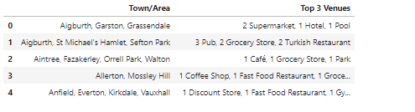
Top 3 venues
Data frame created to show 3 Top venues for each area in Liverpool.

Slide 14
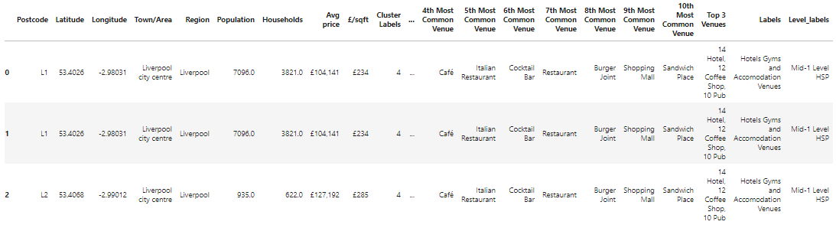
Results
Final data frame showing Cluster Labels, Housing Price Ranges and Top 3 Venues for Each Area

Slide 15
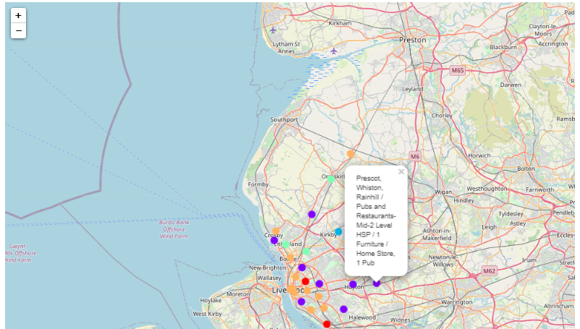
Map with clustered map of Liverpool

Slide 16
Discussion
As mentioned at the beginning of this project Liverpool is a big city with a high population density. Due to a big complexity many different approaches can be used to cluster and classify areas. It’s worth to remember that not every approach will result in the same high quality.
I decided to use KMeans algorithm due to the fact that I have received an optimum k which gave me an insight of the best division of the areas. To this project I have used the areas from postcodes L1-L40 and this is due the fact that the data I obtained for average housing price was only for these postcodes. Nevertheless for more detailed and accurate guidance for investors or residents of the city who are looking for a new place to live that data set can be expanded to more areas and more detailed analysis can be obtained.
The next step of this project can be adding a choropleth map to show average housing sales price and additional features as areas, clusters names and top 3 venues. Unfortunatelly I was not able to obtained a correct map that would show me the wards of Liverpool in the areas as in my data set neither in JSON or SHP format.
The project finished on the stage of visualizing the data and clustering the information on the Liverpool map.

Slide 17

Conclusion
People are interested in Liverpool not only because the beauty of this city but also because if the history, culture, fantastic people, football souls, universities and lots of different attractions throughout the city. It is a good destination for investors to start a new business as well as for people to work here and live.
The information showed in this study can help people/investors/managers to understand the areas of Liverpool, their popular venues as well as the housing prices in Liverpool City.

Slide 18
Discussion
As mentioned at the beginning of this project Liverpool is a big city with a high population density. Due to a big complexity many different approaches can be used to cluster and classify areas. It’s worth to remember that not every approach will result in the same high quality.
I decided to use KMeans algorithm due to the fact that I have received an optimum k which gave me an insight of the best division of the areas. To this project I have used the areas from postcodes L1-L40 and this is due the fact that the data I obtained for average housing price was only for these postcodes. Nevertheless for more detailed and accurate guidance for investors or residents of the city who are looking for a new place to live that data set can be expanded to more areas and more detailed analysis can be obtained.
The next step of this project can be adding a choropleth map to show average housing sales price and additional features as areas, clusters names and top 3 venues. Unfortunatelly I was not able to obtained a correct map that would show me the wards of Liverpool in the areas as in my data set neither in JSON or SHP format.
The project finished on the stage of visualizing the data and clustering the information on the Liverpool map.

Slide 19

THANK YOU!
Sylwia Mierzejowska

